Slide 1
Unit 3 Data Link Layer [8 hrs]

Slide 2
Function of Data Link Layer (DLL)
Overview of Logical Link Control (LLC) and Media Access Control (MAC)
Framing and Flow Control Mechanisms Stop-and-wait ARQ, Piggybacking, Go-Back-N ARQ, Selective Repeat ARQ
Error Detection and Correction techniques Parity checks, Cheksumming Methods, CRC, Hamming code
Channel Allocation Techniques ALOHA, Slotted ALOHA, CSMA, CSMACD,CSMA/CA
Ethernet Standards 802.3 CSMA/CD, 802.4 Token Bus, 802.5 Token Ring
Wireless LAN Spread Spectrum, Bluetooth, Wi-Fi
Overview Virtual Circuit Switching, Frame Relay & ATM
DLL Protocol HDLC, PPP

Slide 3
Link Layer Services
Framing
DLL divides the bits received from network layer into frames. (Frame contains all the addressing information necessary to travel from S to D).
After creating frames, DLL adds physical address of sender/receiver (MAC address) in the header of each frame.
Link Access
When single common Channel is shared by multiple devices, MAC layer of DLL provides help to determine which device has control over the channel.
Reliable delivery between the adjacent nodes
it guarantees to move each network-layer datagram across the link without error.
Flow Control
DLL prevents the fast sender from drowning the slow receiver.
Error Detection and Error Correction
It provides the mechanism of error control in which it detects & retransmits damaged or lost frames.
Modes of Transmission (full-duplex or half-duplex)
Notes:
It provides the mechanism of error control in which it detects & retransmits damaged or lost frames.

Slide 4
Flow Control

Slide 5
Flow Control
Flow control is the mechanism that ensures the rate at which a sender is transmitting is in proportion with the receiver’s receiving capabilities.
Flow control coordinates the amount of data that can be sent before receiving an acknowledgment.
Flow control tells the sender how much data should be sent to the receiver so that it is not lost.
Nodes on each side of a link have a limited amount of packet buffering capacity.
This is a potential problem, as a receiving node may receive frames at a rate faster than it can process the frames (over some time interval).
Without flow control, the receiver's buffer can overflow and frames can get lost.
Link-layer protocol provides flow control to prevent the sending node from overwhelming the receiving node on the other side of the link.

Slide 6
Flow Control
When a data frame is sent from one host to another over a single medium, it is required that the sender and receiver should work at the same speed.
That is, sender sends at a speed on which the receiver can process and accept the data.
If sender is sending too fast, the receiver may be overloaded and data may be lost.
Flow Control - Purpose:
To stop the overflow at the receiver's end, we use flow control techniques for data transmission.
There are two ways to control the flow of data:
A simple stop and wait Protocol
Sliding Window Protocol

Slide 7
A simple stop and wait Protocol
It is the simplest flow control method.
In this, the sender will send one frame at a time to the receiver.
Until then, the sender will stop and wait for the acknowledgment from the receiver.
When the sender gets the acknowledgment then it will send the next data packet from the queue.
The process of alternately sending and waiting for a frame continues until the sender transmits the EOT (End of transmission) frame.
In this method, only one frame can be in transmission at a time.
It leads to high levels of inefficiency, i.e. less productivity if propagation delay is longer than the transmission delay.
Data transmission is one directional, but must have bidirectional line.

Slide 8
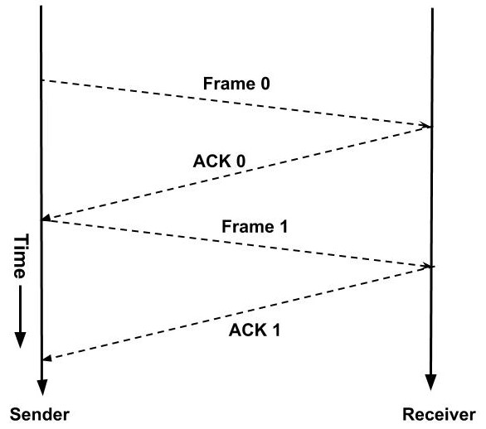
A simple stop and wait Protocol

Slide 9
A simple stop and wait Protocol
Advantage of Stop-and-wait
This method is easy and simple, and each frame is checked and acknowledged before sending
It can also be used for noisy channels without any major issues
This method is also very accurate and there is very little risk of data loss
Disadvantage of Stop-and-wait
The transmission is fairly slow and can be time-consuming
Only one packet or frame can be sent at any point in time.
There is low efficiency as constant feedback is needed after each step

Slide 10
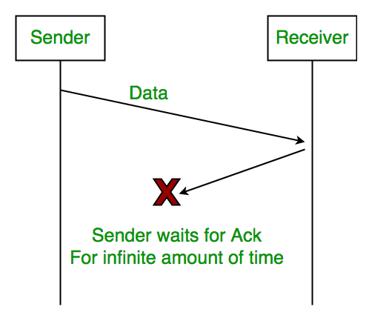
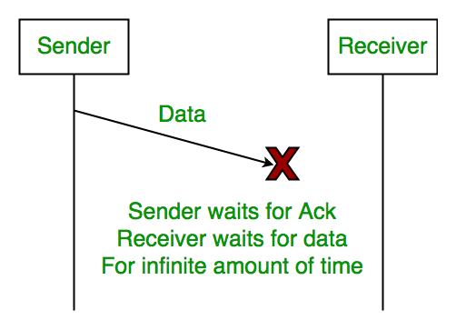
A simple stop and wait Protocol: Problem
Loss of data packet
Loss of acknowledgement
Delayed Acknowledgement
Notes:
When data is lost
Sender waits for an infinite amount of time for an acknowledgment.
Receiver waits for an infinite amount of time for a data.
When ACK is lost
Sender waits for an infinite amount of time for an acknowledgment.

Slide 11
Stop and wait ARQ
Stop and Wait ARQ is an improved and modified version of Stop and Wait protocol.
The sender maintains a timeout counter.
When a frame is sent, the sender starts the timeout counter.
If acknowledgement of frame comes in time, the sender transmits the next frame in queue.
If acknowledgement does not come in time, the sender assumes that either the frame or its acknowledgement is lost in transit. Sender retransmits the frame and starts the timeout counter.
If a negative acknowledgement is received, the sender retransmits the frame.

Slide 12
Stop and wait ARQ

Slide 13
Sliding Window Protocol

Slide 14
Sliding Window Protocol
Advantages of Sliding Window
It performs better than stop-and-wait flow control.
This method is highly efficient
Multiples frames can be sent one after another.
Disadvantages of Sliding Window
The main issue is with the complexity as multiple frames are transferred.
The receiver might receive data frames or packets out of sequence.

Slide 15
Error Detection and Correction techniques

Slide 16
Error
When data is transmitted from one device to another device, the system does not guarantee whether the data received by the device is identical to the data transmitted by another device.
An Error is a situation when the message received at the receiver end is not identical to the message transmitted.
There are many reasons such as noise, cross-talk, physical defects, environmental interferences, etc., which may help data to get corrupted during transmission.
That means a 0 bit may change to 1 or a 1 bit may change to 0.
Types of Errors
Single Bit Error
Multiple Bit Error
Burst Error

Slide 17
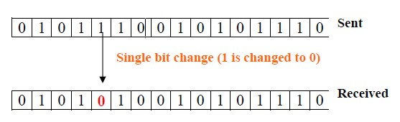
Single Bit Error
The only one bit of a given data unit is changed from 1 to 0 or from 0 to 1.

Slide 18
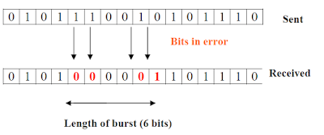
Multiple Bit Error
The two or more bits are changed from 0 to 1 or from 1 to 0 is known as Burst Error.

Slide 19
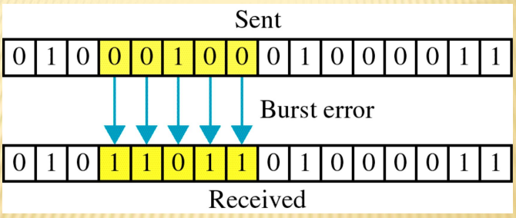
Burst Bit Error
The two or more consecutive bits are changed from 0 to 1 or from 1 to 0 is known as Burst Error.

Slide 20
Redundancy
In this concept a shorter group of bits may be appended to the end of each data unit before the transmission and they are discarded as soon as accuracy of the transmission has been confirmed.

Slide 21
Types of Error Detection Techniques
Types of error detection techniques:
Parity check
Cyclic Redundancy Check
Checksum

Slide 22
Parity Checking
Parity checking is a simple error detection method used with character oriented protocols.
There are two types of parity checking techniques, such as Even parity and Odd parity.
One bit in every character bit sequence is reserved for parity.

Slide 23
Parity Checking: EVEN Parity
In even parity, the number of bits with a value of one are counted.
If that number is odd, the parity bit value is set to one to make the total number of ones in the set (including the parity bit) an even number.
If the number of bits with a value of one is even, the parity bit value is set to zero, so that the total number of ones in the set (including the parity bit) remains an even number.

Slide 24
Parity Checking: ODD Parity
In odd parity, if the number of bits with a value of one is an even number, the parity bit value is set to one to make the total number of ones in the set (including the parity bit) an odd number.
If the number of bits with a value of one is odd, the parity bit value is set to zero, so that the total number of ones in the set (including the parity bit) remains an odd number.

Slide 25
Parity Checking
At the receiving end, each group of incoming bits is checked to see if the group totals to an even or odd number.
The receiver simply counts the number of 1s in a frame.
If the count of 1s is even and even parity is used, the frame is considered to be not-corrupted and is accepted.
If the count of 1s is odd and odd parity is used, the frame is still not corrupted.
If a single bit flips in transit, the receiver can detect it by counting the number of 1s.
But when more than one bits are erroneous, then it is very hard for the receiver to detect the error.
If a transmission error occurs, the transmission is retried or the system halts and an error message is sent to the user.

Slide 26
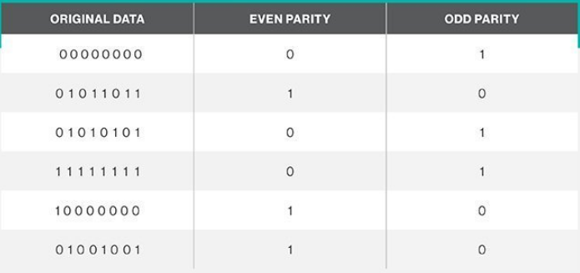
Parity Checking

Slide 27
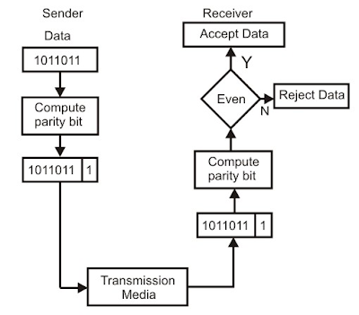
Parity Checking

Slide 28
Checksum
Checksum is also one of the error detection code.
By themselves, checksums are often used to verify data integrity but are not relied upon to verify data authenticity.
In other words, it is a sum that checks the validity of data.
Some common applications include verifying a disk image or checking the integrity of a downloaded file.

Slide 29
Checksum
You can use checksums to check files and other data for errors that occur during transmission or storage.
For example, a file might not have properly downloaded due to network issues, or hard drive problems could have caused corruption in a file on disk.
If you know the checksum of the original file, you can run a checksum or hashing utility on it.
If the resulting checksum matches, you know the file you have is identical.

Slide 30
Checksum: Process
Steps:
Data is divided into fixed sized frames or segments. (k segments each of m bits)
The sender adds the segments using 1’s complement arithmetic to get the sum.
It then complements the sum to get the checksum and sends it along with the data frames.
The receiver adds the incoming segments along with the checksum using 1’s complement arithmetic to get the sum and then complements it.
If the result is zero, the received frames are accepted; otherwise, they are discarded.

Slide 31
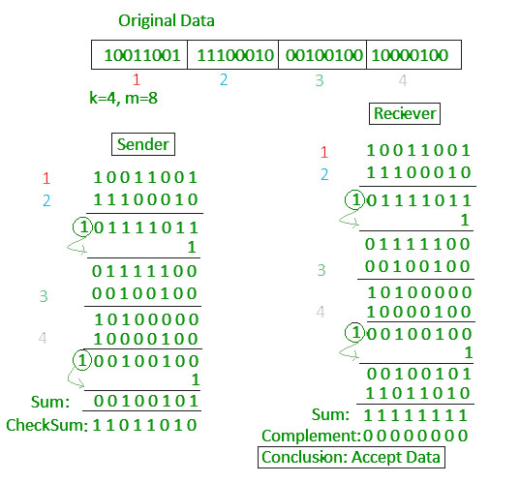
Checksum: Example

Slide 32
Redundancy

Slide 33
Cyclic Redundancy Check
A cyclic redundancy check (CRC) is an error-detecting code commonly used in digital networks and storage devices to detect accidental changes to raw data.
Unlike checksum scheme, which is based on addition, CRC is based on binary division.
In CRC, a sequence of redundant bits, called cyclic redundancy check bits, are appended to the end of data unit so that the resulting data unit becomes exactly divisible by a second, predetermined binary number.
At the destination, the incoming data unit is divided by the same number.
If at this step there is no remainder, the data unit is assumed to be correct and is therefore accepted.
A remainder indicates that the data unit has been damaged in transit and therefore must be rejected.

Slide 34
CRC
The exact number of extra bits and their makeup depends on a generating polynomial.
For example one such polynomial is: x⁴ +x² +x +1
A Standard Generating Polynomial - CRC(CCITT)
The number of CRC bits corresponds to the order of the generating polynomial.
The above polynomial of order 4 generates a 4-bit CRC.
Typically, the CRC bits are used for error detection only.

Slide 35
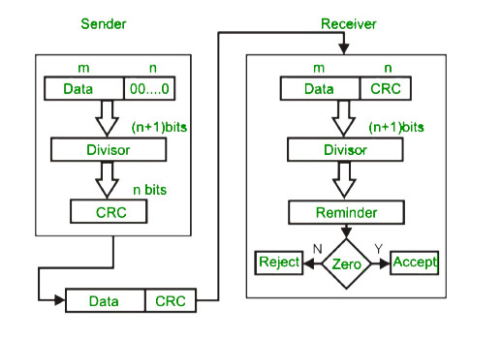
CRC

Slide 36
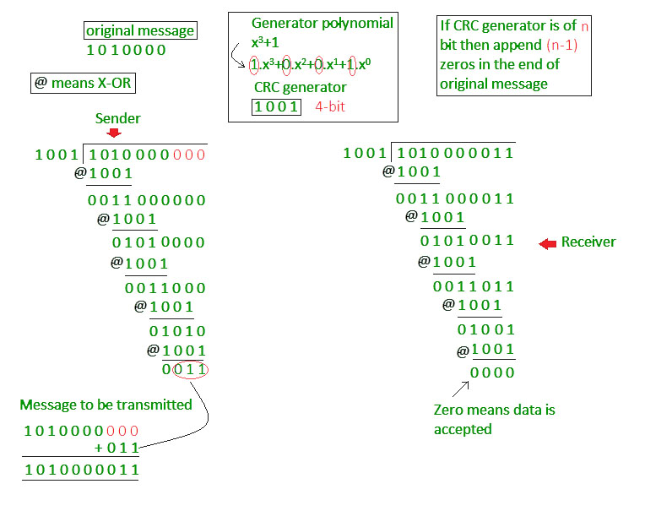
CRC

Slide 37
Hamming Code
Hamming code is a set of error-correction codes that can be used to detect and correct the errors that can occur when the data is moved or stored from the sender to the receiver.
It is technique developed by R.W. Hamming in 1950 for error correction.
Hamming codes detect 1-bit and 2-bit errors.

Slide 38
Hamming Code
Encoding the message with hamming code
Selecting the number of redundant bits
Choosing the location of redundant bits
Assigning the values to redundant bits

Slide 39
Selecting the number of redundant bits
The hamming code uses the number of redundant bits depending on the number of information bits in the message.
Let n be the number of information or data bits, then the number of redundant bits P is determined from the following formula,
2^{P} ≥ n + P + 1

Slide 40
Selecting the number of redundant bits
For example, If 4-bit information is to be transmitted, then n=4.
The number of redundant bits is determined by the trial and error method.
Let P=2, we get,
2² ≥ 4 + 2 + 1
The above equation implies 4 not greater than or equal to 7.
So let’s choose another value of P=3.
2³ ≥ 4 + 3 + 1
Now, the equation satisfies the condition.
So number of redundant bits, P=3.
In this way, the number of redundant bits is selected for the number of information bits to be transmitted.

Slide 41
Choosing the location of redundant bits
For the above example, the number of data bits n=4, and the number of redundant bits P=3.
So the message consists of 7 bits in total that are to be coded.
Let the rightmost bit be designated as bit 1, the next successive bit as bit 2 and so on.
The seven bits are bit 7, bit 6, bit 5, bit 4, bit 3, bit 2, bit 1.
In this, the redundant bits are placed at the positions that are numbered corresponding to the power of 2, i.e., 1, 2, 4, 8,…
Thus the locations of data bit and redundant bit are D4, D3, D2, P3, D1, P2, P1.

Slide 42
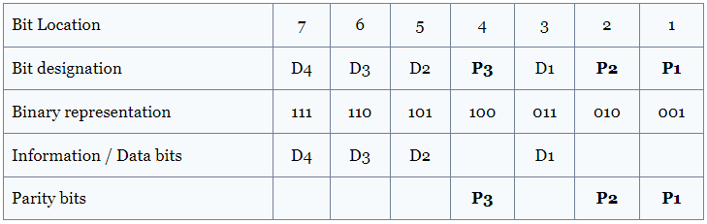
Assigning the values to redundant bits
Now it is time to assign bit value to the redundant bits in the formed hamming code group.
The assigned bits are called a parity bit.
Each parity bit will check certain other bits in the total code group.
It is one with the bit location table, as shown below.

Slide 43
Assigning the values to redundant bits
Parity bit P1 covers all data bits in positions whose binary representation has 1 in the least significant position(001, 011, 101, 111, etc.).
Thus P1 checks the bit in locations 1, 3, 5, 7, 9, 11, etc..
Parity bit P2 covers all data bits in positions whose binary representation has 1 in the second least significant position(010, 011, 110, 111, etc.).
Thus P2 checks the bit in locations 2, 3, 6, 7, etc.
Parity bit P3 covers all data bits in positions whose binary representation has 1 in the third least significant position(100, 101, 110, 111, etc.).
Thus P3 checks the bit in locations 4, 5, 6, 7, etc.
Each parity bit checks the corresponding bit locations and assign the bit value as 1 or 0, so as to make the number of 1s as even for even parity and odd for odd parity.

Slide 44
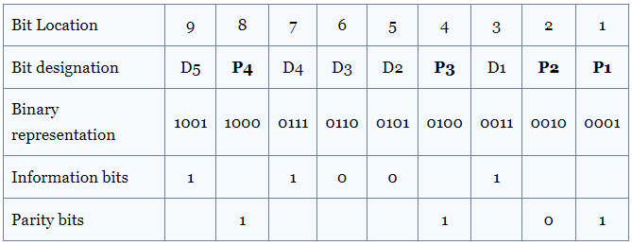
Example
Encode a binary word 11001 into the even parity hamming code.
Given, number of data bits, n =5.
To find the number of redundant bits,
Let us try P=4.
The equation is satisfied and so 4 redundant bits are selected.
So, total code bit = n+P = 9
The redundant bits are placed at bit positions 1, 2, 4 and 8.
Construct the bit location table.

Slide 45
Example
To determine the parity bits
For P1:
Bit locations 3, 5, 7 and 9 have three 1s. To have even parity, P1 must be 1.
For P2:
Bit locations 3, 6, 7 have two 1s. To have even parity, P2 must be 0.
For P3:
Bit locations 5, 6, 7 have one 1s. To have even parity, P3 must be 1.
For P4:
Bit locations 8, 9 have one 1s. To have even parity, P2 must be 1.
Thus the encoded 9-bit hamming code is 111001101.

Slide 46
How to detect and correct the error in the hamming code?
After receiving the encoded message, each parity bit along with its corresponding group of bits are checked for proper parity.
While checking, the correct result of individual parity is marked as 0 and the wrong result is marked as 1.
After checking all the parity bits, a binary word is formed taking the result bits for P1 as LSB.
So formed binary word gives the bit location, where there is an error.
If the formed binary word has 0 bits, then there is no error in the message.

Slide 47
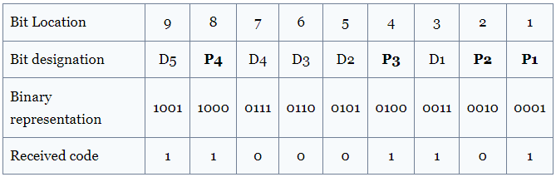
Example 2
Let us assume the even parity hamming code from the above example (111001101) is transmitted and the received code is (110001101). Now from the received code, let us detect and correct the error.
To detect the error, let us construct the bit location table.

Slide 48
Checking the parity bits
For P1 :
Check the locations 1, 3, 5, 7, 9. There is three 1s in this group, which is wrong for even parity. Hence the bit value for P1 is 1.
For P2 :
Check the locations 2, 3, 6, 7. There is one 1 in this group, which is wrong for even parity. Hence the bit value for P2 is 1.
For P3 :
Check the locations 3, 5, 6, 7. There is one 1 in this group, which is wrong for even parity. Hence the bit value for P3 is 1.
For P4 :
Check the locations 8, 9. There are two 1s in this group, which is correct for even parity. Hence the bit value for P4 is 0.
The resultant binary word is 0111. It corresponds to the bit location 7 in the above table.
The error is detected in the data bit D4.
The error is 0 and it should be changed to 1.
Thus the corrected code is 111001101.

Slide 49
Channel Allocation Techniques

Slide 50
Channel Allocation Techniques
ALOHA
Pure ALHOA
Slotted ALOHA
CSMA
CSMA/CD
CSMA/CA

Slide 51
Channel Allocation Techniques
It deals how to determine that who may use the network next when the network consists of a single shared channel, as in most networks.
Notes:
Networks can be divided into two categories: those using point-to-point connections and those using broadcast channels.
In any broadcast network, the key issue is how to determine who gets to use the channel when there is competition for it.
To make this point clearer, consider a conference call in which six people, on six different telephones, are all connected so that each one can hear and talk to all the others.
It is very likely that when one of them stops speaking, two or more will start talking at once, leading to chaos. When only a single channel is available, determining who should go next is much harder.

Slide 52
Ethernet Standards: 802.3 CSMA/CD, 802.4 Token Bus, 802.5 Token Ring

Slide 53
Ethernet (contd…)
Ethernet, a family of wired computer networking technologies, is the most popular physical layer LAN technology in use today.
It defines the number of conductors that are required for a connection, the performance thresholds that can be expected, and provides the framework for data transmission.
A standard Ethernet network can transmit data at a rate up to 10 Megabits per second (10 Mbps).
Other LAN types include Token Ring, Fast Ethernet, Gigabit Ethernet, 10 Gigabit Ethernet, Fiber Distributed Data Interface (FDDI), Asynchronous Transfer Mode (ATM) and LocalTalk.
Notes:
Networks can be divided into two categories: those using point-to-point connections and those using broadcast channels.
In any broadcast network, the key issue is how to determine who gets to use the channel when there is competition for it.
To make this point clearer, consider a conference call in which six people, on six different telephones, are all connected so that each one can hear and talk to all the others.
It is very likely that when one of them stops speaking, two or more will start talking at once, leading to chaos. When only a single channel is available, determining who should go next is much harder.

Slide 54
Ethernet
Ethernet is popular because it strikes a good balance between speed, cost and ease of installation.
These benefits, combined with wide acceptance in the computer marketplace and the ability to support virtually all popular network protocols, make Ethernet an ideal networking technology for most computer users today.
The Institute for Electrical and Electronic Engineers developed an Ethernet standard known as IEEE Standard 802.3.
This standard defines rules for configuring an Ethernet network and also specifies how the elements in an Ethernet network interact with one another.
By adhering to the IEEE standard, network equipment and network protocols can communicate efficiently.
Notes:
Networks can be divided into two categories: those using point-to-point connections and those using broadcast channels.
In any broadcast network, the key issue is how to determine who gets to use the channel when there is competition for it.
To make this point clearer, consider a conference call in which six people, on six different telephones, are all connected so that each one can hear and talk to all the others.
It is very likely that when one of them stops speaking, two or more will start talking at once, leading to chaos. When only a single channel is available, determining who should go next is much harder.

Slide 55
Why use Ethernet?
Given that wireless connectivity is a staple of most devices today, you may wonder why anyone needs to know about Ethernet beyond its role as the backbone of a business network.
The reality is that Ethernet still occasionally finds a use, largely due to the limitations of wireless technology.
A business Wi-Fi network is not always the easiest thing to deploy, especially in larger offices with lots of corridors, walls, and multiple floors that will block or hinder connectivity.
This is especially noticeable when a business has a hotdesking policy, as the quality of the connection can vary considerably as you move around a building.
To keep some semblance of a consistent connection, it’s common for office spaces to still offer a wired Ethernet link to the network.
It’s not just the quality of the connection, either.
Wired connections generally deliver much faster, and far more consistent, speeds than the typical wireless connection, even if you’re sitting next to the router.
In theory, recent innovations in wireless technology should make wired connections obsolete.
Wi-Fi 6, for example, should be a match for any speed you would get through a wire.
Yet, wireless connections are still at the mercy of the environment they’re deployed in, and until thick walls and floors no longer hinder connections, Ethernet will always have a place.
Notes:
Networks can be divided into two categories: those using point-to-point connections and those using broadcast channels.
In any broadcast network, the key issue is how to determine who gets to use the channel when there is competition for it.
To make this point clearer, consider a conference call in which six people, on six different telephones, are all connected so that each one can hear and talk to all the others.
It is very likely that when one of them stops speaking, two or more will start talking at once, leading to chaos. When only a single channel is available, determining who should go next is much harder.

Slide 56
Standard Ethernet Code
In order to understand standard Ethernet code, one must understand what each digit means. Following is a guide:
Guide to Ethernet Coding
For example:
100BASE-TX indicates a Fast Ethernet connection (100 Mbps) that uses a twisted pair cable capable of full-duplex transmissions.
10 | at the beginning means the network operates at 10Mbps.
BASE | means the type of signaling used is baseband.
2 or 5 | at the end indicates the maximum cable length in meters.
T | the end stands for twisted-pair cable.
X | at the end stands for full duplex-capable cable.
FL | at the end stands for fiber optic cable.
Notes:
Networks can be divided into two categories: those using point-to-point connections and those using broadcast channels.
In any broadcast network, the key issue is how to determine who gets to use the channel when there is competition for it.
To make this point clearer, consider a conference call in which six people, on six different telephones, are all connected so that each one can hear and talk to all the others.
It is very likely that when one of them stops speaking, two or more will start talking at once, leading to chaos. When only a single channel is available, determining who should go next is much harder.

Slide 57
Widely used Ethernet cables
10Base2: This is a thin twisted pair coaxial cable.
10Base5: This is thick twisted pair coaxial cables.
10Base T: This is a twisted pair cable which offers a speed of around 10 Mbps.
100BaseTX: This is a twisted pair cable and offer a speed of 100 Mbps.
100Base FX: Fiber optic protocol which offers a speed of 100 Mbps.
1000Base SX: Fiber optic protocol which utilizes a wavelength of 850nm for multimode networks.
1000Base LX: Fiber optic protocol which utilizes a wavelength of 1310 nm, for multimode networks and up to 1550nm for singlemode networks.
Notes:
Networks can be divided into two categories: those using point-to-point connections and those using broadcast channels.
In any broadcast network, the key issue is how to determine who gets to use the channel when there is competition for it.
To make this point clearer, consider a conference call in which six people, on six different telephones, are all connected so that each one can hear and talk to all the others.
It is very likely that when one of them stops speaking, two or more will start talking at once, leading to chaos. When only a single channel is available, determining who should go next is much harder.

Slide 58
Ethernet
Name | IEEE Standard | Data Rate | Media Type | Maximum Distance
Ethernet | 802.3 | 10 Mbps | 10Base-T | 100 meters
Fast Ethernet/ 100Base-T | 802.3u | 100 Mbps | 100Base-TX 100Base-FX | 100 meters 2000 meters
Gigabit Ethernet/ GigE | 802.3z | 1000 Mbps | 1000Base-T 1000Base-SX 1000Base-LX | 100 meters 275/550 meters 550/5000 meters
10 Gigabit Ethernet | IEEE 802.3ae | 10 Gbps | 10GBase-SR 10GBase-LX4 10GBase-LR/ER 10GBase-SW/LW/EW | 300 meters 300m MMF/ 10km SMF 10km/40km 300m/10km/40km
Notes:
Networks can be divided into two categories: those using point-to-point connections and those using broadcast channels.
In any broadcast network, the key issue is how to determine who gets to use the channel when there is competition for it.
To make this point clearer, consider a conference call in which six people, on six different telephones, are all connected so that each one can hear and talk to all the others.
It is very likely that when one of them stops speaking, two or more will start talking at once, leading to chaos. When only a single channel is available, determining who should go next is much harder.

Slide 59
Ethernet Network
Fast Ethernet
As the term suggests, this is quite a high-speed internet, and can transmit or receive data at about 100 Mbps.
This type of network is usually supported by a twisted pair or CAT5 cable.
If a laptop, camera, or any other device is connected to a network, they operate at 10/100Base Ethernet and 100Base on the fiber side of the link.
Gigabit Ethernet
This type of network transfers data at an even higher speed of about 1000 Mbps or 1Gbps.
Gigabit speed is an upgrade from Fast Ethernet which is slowly being phased out.
In this type of network, all the four pairs in the twisted pair cable contribute to the data transfer speed.
This network type finds a large application in video calling systems which use CAT5e or other advanced cables.
For extended networks, the distance of up to 500m, 1000Base SX fiber cables may be used for multimode, as well as 1000Base LX for single mode systems.
VERSITRON manufactures Gigabit Ethernet Media Converters that can handle 10/100/1000Base speeds on the Ethernet side and 1000Base Gigabit speed on the fiber side by using Fiber SFP modules.
Notes:
Networks can be divided into two categories: those using point-to-point connections and those using broadcast channels.
In any broadcast network, the key issue is how to determine who gets to use the channel when there is competition for it.
To make this point clearer, consider a conference call in which six people, on six different telephones, are all connected so that each one can hear and talk to all the others.
It is very likely that when one of them stops speaking, two or more will start talking at once, leading to chaos. When only a single channel is available, determining who should go next is much harder.

Slide 60
Ethernet Network
10-Gigabit Ethernet
This is an even more advanced and high speed network type with a data transfer rate of 10 Gigabit/second.
It is supported by CAT6a or CAT7 twisted pair cables, as well as fiber optic cables.
By using a fiber optic cable, this network area can be extended up to around 10,000 meters.
Switch Ethernet
This type of network requires a switch or hub.
Also, instead of a twisted pair cable, a normal network cable is used in this case.
Network switches are used for data transfer from one device to the other, without interrupting any other devices in the network.
Notes:
Networks can be divided into two categories: those using point-to-point connections and those using broadcast channels.
In any broadcast network, the key issue is how to determine who gets to use the channel when there is competition for it.
To make this point clearer, consider a conference call in which six people, on six different telephones, are all connected so that each one can hear and talk to all the others.
It is very likely that when one of them stops speaking, two or more will start talking at once, leading to chaos. When only a single channel is available, determining who should go next is much harder.

Slide 61
Cable Grade Capabilities
Cable Name | Makeup | Frequency Support | Data Rate | Network Compatibility
Cat-5 | 4 twisted pairs of copper wire — terminated by RJ45 connectors | 100 MHz | Up to 1000Mbps | ATM, Token Ring,1000Base-T, 100Base-TX, 10Base-T
Cat-5e | 4 twisted pairs of copper wire — terminated by RJ45 connectors | 100 MHz | Up to 1000Mbps | 10Base-T, 100Base-TX, 1000Base-T
Cat-6 | 4 twisted pairs of copper wire — terminated by RJ45 connectors | 250 MHz | 1000Mbps | 10Base-T, 100Base-TX, 1000Base-T
Notes:
Networks can be divided into two categories: those using point-to-point connections and those using broadcast channels.
In any broadcast network, the key issue is how to determine who gets to use the channel when there is competition for it.
To make this point clearer, consider a conference call in which six people, on six different telephones, are all connected so that each one can hear and talk to all the others.
It is very likely that when one of them stops speaking, two or more will start talking at once, leading to chaos. When only a single channel is available, determining who should go next is much harder.

Slide 62
CSMA/CD Standard
One of the main standards of the Ethernet technology is the Carrier Sense Multiple Access/ Collision Detection (CSMA/CD).
Ethernet usually permits each node in the network to transmit data packets at any time without any system of waiting.
This creates a high possibility for data collisions.
Collisions occur when two or more nodes initiate data transmissions on the same channel simultaneously.
When this happens, a packet collision is said to occur.
Think of a busy road intersection with no traffic lights.
When each driver crosses the intersection at will, a collision is likely to occur.
For Ethernet to efficiently manage these collisions, the protocol CSMA/CD is employed.
CSMA/CD therefore defines how the devices involved in the collision must respond.
These definitions dictate how long a device should wait to proceed with data transmission.
If repeated collisions occur devices may wait twice as long before re-transmitting.
Notes:
Networks can be divided into two categories: those using point-to-point connections and those using broadcast channels.
In any broadcast network, the key issue is how to determine who gets to use the channel when there is competition for it.
To make this point clearer, consider a conference call in which six people, on six different telephones, are all connected so that each one can hear and talk to all the others.
It is very likely that when one of them stops speaking, two or more will start talking at once, leading to chaos. When only a single channel is available, determining who should go next is much harder.

Slide 63
CSMA/CD Standard: Access Modes
1-Persistent
Device waits for the channel to be idle then transmits data.
Often used by CSMA/CD systems like Ethernet
P-Persistent
Device waits for the channel to be idle then transmits data with success at probability P.
If the transmission fails at probability (1-P) the device waits for the channel to be idle again and re-transmits.
This is used by CSMA/CA (Carrier Sense Multiple Access/Collision Avoidance) systems like Wi-Fi.
O-Persistent
which develops a transmission queue called a Transmission Order for each device or node.
When the channel is idle the node or device next in line transmits data.
Notes:
Networks can be divided into two categories: those using point-to-point connections and those using broadcast channels.
In any broadcast network, the key issue is how to determine who gets to use the channel when there is competition for it.
To make this point clearer, consider a conference call in which six people, on six different telephones, are all connected so that each one can hear and talk to all the others.
It is very likely that when one of them stops speaking, two or more will start talking at once, leading to chaos. When only a single channel is available, determining who should go next is much harder.

Slide 64
Token Ring
Token Ring is another form of network configuration.
It differs from Ethernet in that all messages are transferred in one direction along the ring at all times.
Token Ring networks sequentially pass a “token” to each connected device.
When the token arrives at a particular computer (or device), the recipient is allowed to transmit data onto the network.
Since only one device may be transmitting at any given time, no data collisions occur.
Access to the network is guaranteed, and time-sensitive applications can be supported.
However, these benefits come at a price.
Component costs are usually higher, and the networks themselves are considered to be more complex and difficult to implement.
Various PC vendors have been proponents of Token Ring networks.
Notes:
Networks can be divided into two categories: those using point-to-point connections and those using broadcast channels.
In any broadcast network, the key issue is how to determine who gets to use the channel when there is competition for it.
To make this point clearer, consider a conference call in which six people, on six different telephones, are all connected so that each one can hear and talk to all the others.
It is very likely that when one of them stops speaking, two or more will start talking at once, leading to chaos. When only a single channel is available, determining who should go next is much harder.

Slide 65
Token Ring
A token ring is a data link for a local area network (LAN) in which all devices are connected in a ring or star topology and pass one or more tokens from host to host.
A token is a frame of data transmitted between network points.
Only a host that holds a token can send data, and tokens are released when receipt of the data is confirmed.
A ring consists of a collection of ring interfaces connected by point-to-point lines i.e. ring interface of one station is connected to the ring interfaces of its left station as well as right station.
IBM developed token ring technology in the 1980s as an alternative to Ethernet.
Notes:
A token is a special frame of 3 bytes that circulates along the ring of stations.

Slide 66
Token Ring: Token Passing
If a station has a frame to transmit when it receives a token, it sends the frame and then passes the token to the next station;
otherwise it simply passes the token to the next station.
Passing the token means receiving the token from the preceding station and transmitting to the successor station.
The data flow is unidirectional in the direction of the token passing.
In order that tokens are not circulated infinitely, they are removed from the network once their purpose is completed.
Furthermore, it also makes sure that one token circulates whenever there is no frame transmission.
It also detects a broken ring and removes circulating frames from the ring. The third field in the token frame is the ending delimiter.

Slide 67
Token Ring: Token Passing

Slide 68
Token Ring: Advantages & Disadvantages
Advantages of token rings
Token rings reduce the chances of data collision.
Token passing performs better than bus topology under heavy traffic.
A server is not needed to control connectivity among the nodes.
Disadvantages of token rings
Data packets must pass through all the nodes, slowing routing.
Token ring networks have suffered from network management problems and poor network fault tolerance.
Token ring is considered obsolete, with the dominance of Ethernet and the IEEE working group having been disbanded.
Notes:
A token is a special frame of 3 bytes that circulates along the ring of stations.

Slide 69
Token Bus
Token Bus (IEEE 802.4) is a standard for implementing token ring over virtual ring in LANs.
The token bus network standard passes tokens along a virtual ring.
The token ring is an IEEE 802.5 standard and is passed over a physical token ring network and not a virtual ring.
The virtual ring is made up of stations that pass tokens during a sequence in a virtual ring.
Each node or station in a token bus network knows both the predecessor station's and successor station's addresses.
In this scenario, a node transmits the data only if it has a token.
Although it is a virtual ring, its working rule is analogous.
Notes:
A token is a special frame of 3 bytes that circulates along the ring of stations.

Slide 70
Token Bus: Token Passing
A token is a small message that circulates among the stations of a computer network providing permission to the stations for transmission.
If a station has data to transmit when it receives a token, it sends the data and then passes the token to the next station; otherwise, it simply passes the token to the next station.

Slide 71
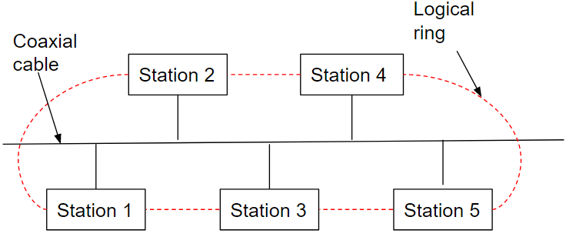
Token Bus: Token Passing

Slide 72
Token Ring Vs Token Bus
Token ring networks are intended for offices, while token bus networks are designed for large industries.
Token Ring | Token Bus
The token is passed over the physical ring formed by the stations and the coaxial cable network. | The token is passed along the virtual ring of stations connected to a LAN.
The stations are connected by ring topology, or sometimes star topology. | The underlying topology that connects the stations is either bus or tree topology.
It is defined by IEEE 802.5 standard. | It is defined by IEEE 802.4 standard.
The maximum time for a token to reach a station can be calculated here. | It is not feasible to calculate the time for token transfer.

Slide 73
Overview Virtual Circuit Switching, Frame Relay & ATM

Slide 74
Virtual Circuit Switching
Virtual circuit switching is a packet switching methodology whereby a path is established between the source and the final destination through which all the packets will be routed during a call.
This path is called a virtual circuit because to the user, the connection appears to be a dedicated physical circuit.
However, other communications may also be sharing the parts of the same path.
Before the data transfer begins, the source and destination identify a suitable path for the virtual circuit.
All intermediate nodes between the two points put an entry of the routing in their routing table for the call.
Additional parameters, such as the maximum packet size, are also exchanged between the source and the destination during call setup.
The virtual circuit is cleared after the data transfer is completed.
Virtual circuit packet switching is connection orientated.
This is in contrast to datagram switching, which is a connection less packet switching methodology.
Examples of virtual circuit switching are X.25 and Frame Relay.

Slide 75
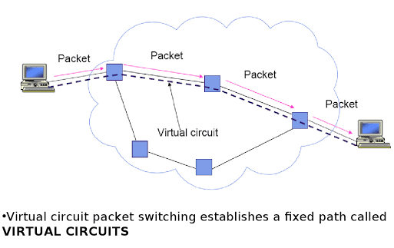
Virtual Circuit Switching

Slide 76
Working of Virtual Circuit
In the first step, a medium is set up between the two end nodes.
Resources are reserved for the transmission of packets.
Then, a signal is sent to sender to tell the medium is set up and transmission can be started.
It ensures the transmission of all packets.
A global header is used in the first packet of the connection.
Whenever data is to be transmitted a new connection is set up.

Slide 77
Virtual Circuit Switching
Advantages of virtual circuit switching are:
Packets are delivered in order, since they all take the same route;
The overhead in the packets is smaller, since there is no need for each packet to contain the full address;
The connection is more reliable,
network resources are allocated at call setup so that even during times of congestion, provided that a call has been setup, the subsequent packets should get through;
Billing is easier, since billing records need only be generated per call and not per packet.
Disadvantages of a virtual circuit switched network are:
The switching equipment needs to be more powerful,
since each switch needs to store details of all the calls that are passing through it and to allocate capacity for any traffic that each call could generate;
Resilience to the loss of a trunk is more difficult,
since if there is a failure all the calls must be dynamically reestablished over a different route.

Slide 78
Frame Relay
Frame relay is a type of telecommunications technology that can be used to connect local area networks (LANs) and to transmit data between endpoints in wide area networks (WANs).
It is a packet switched communication service from LANs (Local Area Network) to backbone networks and WANs.
Frame Relay is a high-performance WAN protocol that operates at the physical and data link layers of the OSI reference model.
Frame Relay originally was designed for use across Integrated Services Digital
Network (ISDN) interfaces. Today, it is used over a variety of other network interfaces as well.

Slide 79
Frame Relay
Frame Relay uses virtual circuits to connect a single router to multiple remote sites.
In most cases, permanent virtual circuits are used, i.e. a fixed network-assigned circuit is used through which the user sees a continuous uninterrupted line.
However, switched virtual circuits may also be used.
Data is transmitted by encapsulating them in multiple sized frames.
Frame relay forwards data elements between source and destination without applying any internal error detection or correction.
Error correction is handled by the endpoints, which are responsible for retransmission of dropped frames
Error correction is done on an end-to-end basis rather than a link -to-link basis as in X.25 switching.

Slide 80
Frame Relay
Frame relay has evolved from X.25 packet switching and objective is to reduce network delays, protocol overheads and equipment cost.
Frame relay can support multiple users over the same line and can establish a permanent virtual circuit or a switched virtual circuit.
Frame relay is considered to be a protocol, which must be carried over a physical link.
While useful for connection of LANs, the combination of low throughput, delay variation and frame discard when the link is congested will limit its usefulness to multimedia.

Slide 81
Characteristics of Frame Relay
Frame Relay service is a service that supports the transport of data
Frame relay is a connectionless service, meaning that each data packet passing through the network contains -address information
Frame relay is a service that is provided with a variety of speeds from 56 Kbs up to 25 Mbs.
Even though the most used speeds for the service are currently 56 Kbs and 1.544 Mbs
Frames are variable in length and goes up to 4,096 bytes
Frame Relay is considered to be a Broadband ISDN service
One of the unique facets of frame relay service is that the service supports variable size data packets.

Slide 82
Various key features of this protocol
The call control packets are used for setting up and clearing virtual circuits.
In band signaling is used.
Multiplexing of virtual circuits takes place at layer 3.
Layer 2 and 3 include flow control and error control.

Slide 83
Important features of Frame Relay
Frame relay operates at a high speed (1.544 Mbps to 44.376 Mbps).
Frame relay operates only in the physical and data link layers. So it can be easily used in Internet.
It allows the bursty data.
It has a large frame size of 9000 bytes.
So it can accommodate all local area network frame sizes.
Frame relay can only detect errors (at the data link layer). But there is no flow control or error control.
The damaged frame is simply dropped.
There is no retransmission.
This is to increase the speed.
So frame relay needs a reliable medium and protocols having flow and error control.

Slide 84
Frame Relay: Benefits
It helps in reducing the cost of internetworking, as there is considerable reduction in the number of circuits required and the associated bandwidths.
It helps in increasing the performance due to reduced network complexity.
It increases the interoperability with the help of international standards.
Frame Relay is protocol independent and can easily be used to combine traffic from other networking protocols.

Slide 85
Frame Relay: Advantages and Disadvantages
Advantages:
High speed
Scalable
Reduced network congestion
Cost-efficient
Secured connection
Disadvantages:
Lacks error control mechanism
Delay in packet transfer
Less reliable

Slide 86
Frame Relay: Advantages
Streamlined communication process.
The number of functions of a protocol at the user-network interface is reduced.
Lower delay.
Higher throughput.
Frame relay can be used at access speeds upto 2 Mbps.
Frame Relay is cost- effective, partly due to the fact that the network buffering requirements are carefully optimized.
Compared to X.25, with its store and forward mechanism and full error correction, network buffering is minimal.
Frame Relay is also much faster than X.25: the frames are switched to their destination with only a few byte times delay, as opposed to several hundred milliseconds delay on X.25.

Slide 87
Frame Relay: Disadvantages
Frames are delivered unreliably.
Packets may not be delivered in the same sequence as that at the sending end.
Packets having errors are simply discarded.
Frame relay does not provide flow control.
It does not provide the acknowledgement of received packets.
Frame discarded in case of network congestion. If congestion occurs in the network, frame (data) is discarded within the network without re-transmission of this frame. The sender must perform re-transmission control at his own responsibility.

Slide 88
Asynchronous Transfer Mode (ATM)
ATM stands for Asynchronous transfer mode.
It is a switching technique used by telecommunication networks that uses asynchronous time-division multiplexing to encode data into small, fixed-sized cells.
ATMs can be used for efficient data transfer over highspeed data networks.
ATM provides real-time and non-real-time services.
ATM networks are connection oriented networks for cell relay that supports voice, video and data communications. It encodes data into small fixed - size cells so that they are suitable for TDM and transmits them over a physical medium.
Notes:
Networks can be divided into two categories: those using point-to-point connections and those using broadcast channels.
In any broadcast network, the key issue is how to determine who gets to use the channel when there is competition for it.
To make this point clearer, consider a conference call in which six people, on six different telephones, are all connected so that each one can hear and talk to all the others.
It is very likely that when one of them stops speaking, two or more will start talking at once, leading to chaos. When only a single channel is available, determining who should go next is much harder.

Slide 89
Asynchronous Transfer Mode (ATM)
ATM is a connection-oriented protocol that can work with either permanent virtual circuits (PVCs) or switched virtual circuits (SVCs), depending on your wide area network (WAN) traffic needs.
ATM networks use bandwidth at maximum efficiency while maintaining a guaranteed quality of service (QoS) for users and applications that require it.
The two main benefits of ATM are
its high transmission speeds and
its flexible bandwidth-on-demand capability.

Slide 90
Asynchronous Transfer Mode (ATM)
ATM is a cell-based fast-packet communication technique that can support data-transfer rates from sub-T1 speeds to 10 Gbps.
ATM achieves its high speeds in part by transmitting data in fixed-size cells and dispensing with error-correction protocols.
It relies on the inherent integrity of digital lines to ensure data integrity.
ATM can be integrated into an existing network as needed without having to update the entire network.
Its fixed-length cell-relay operation is the signaling technology of the future and offers more predictable performance than variable length frames.
Networks are extremely versatile and an ATM network can connect points in a building, or across the country, and still be treated as a single network.
Notes:
Networks can be divided into two categories: those using point-to-point connections and those using broadcast channels.
In any broadcast network, the key issue is how to determine who gets to use the channel when there is competition for it.
To make this point clearer, consider a conference call in which six people, on six different telephones, are all connected so that each one can hear and talk to all the others.
It is very likely that when one of them stops speaking, two or more will start talking at once, leading to chaos. When only a single channel is available, determining who should go next is much harder.

